Slide 1

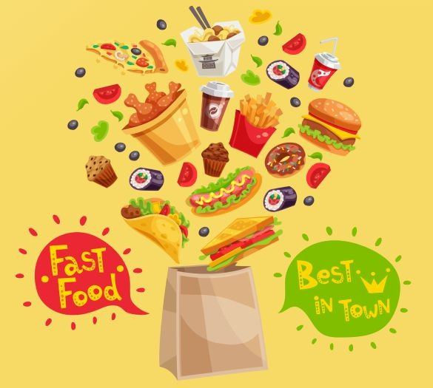




Product Canvas
DeliverEase
Done by
Sai Sirisha NK

Slide 2
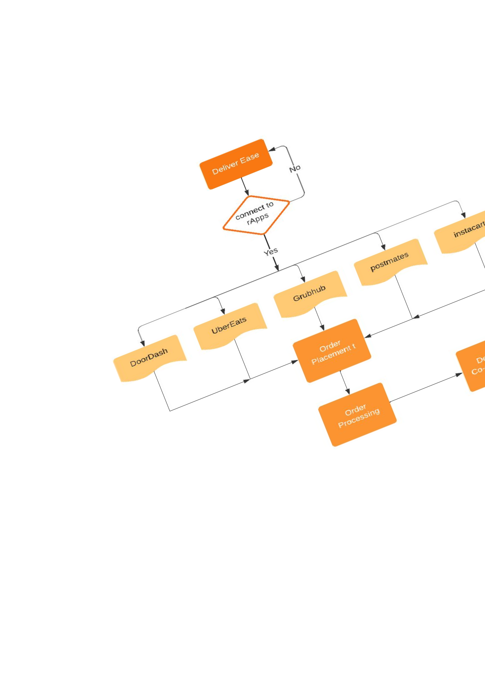
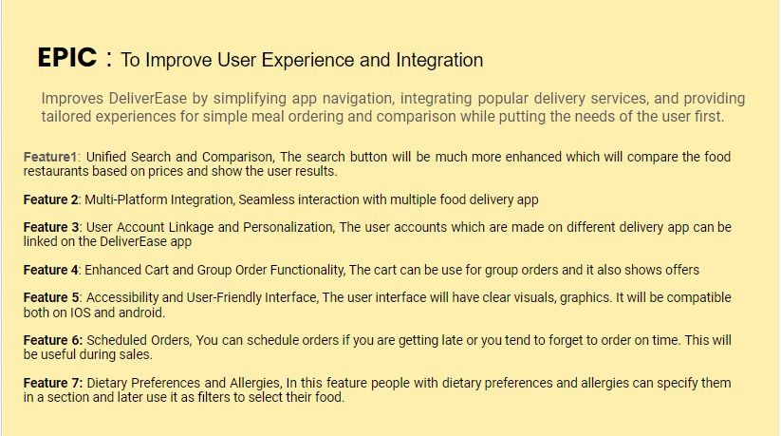
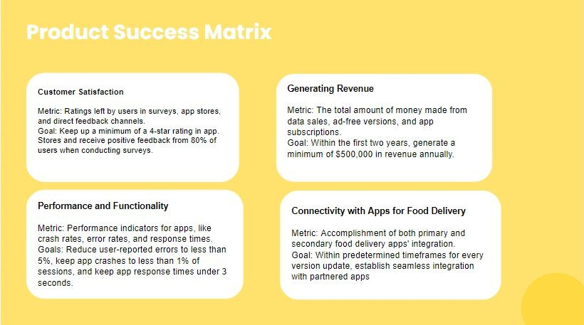
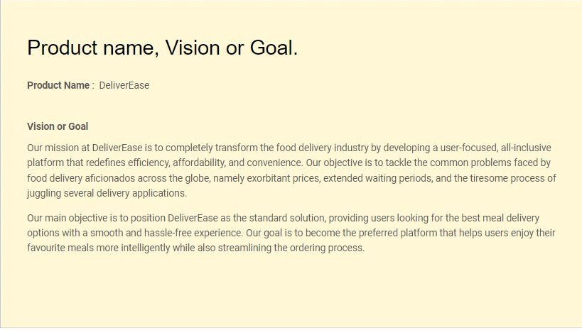
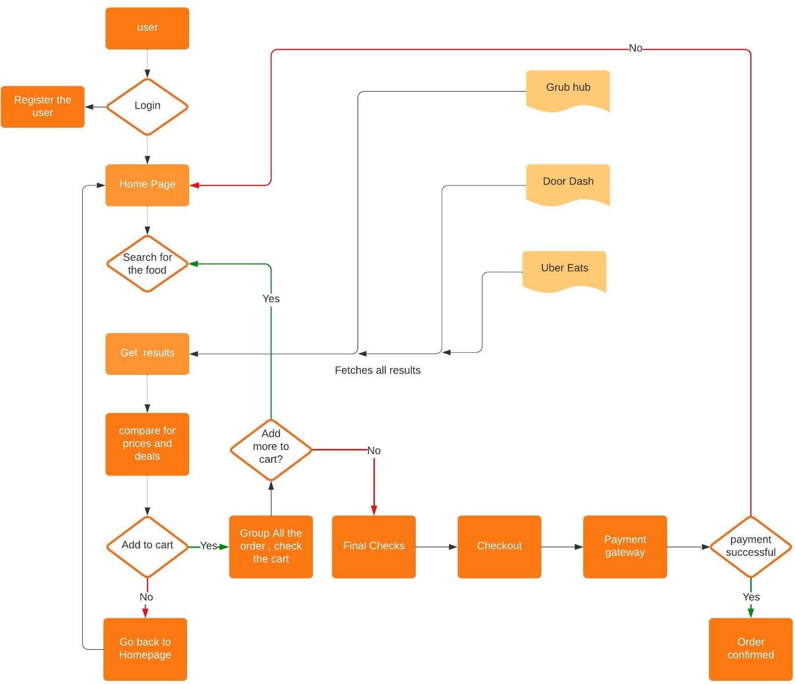
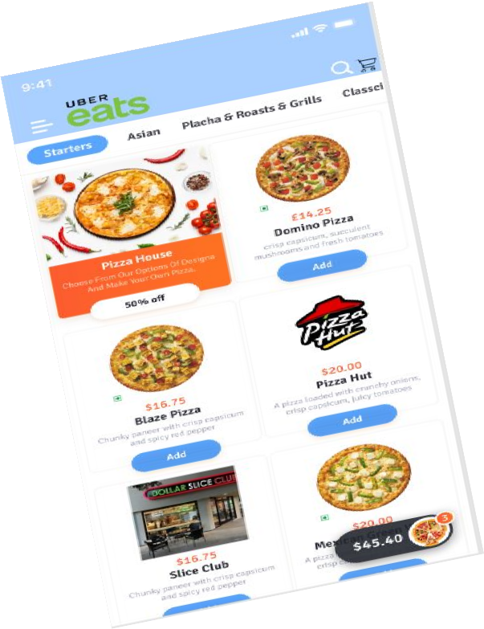
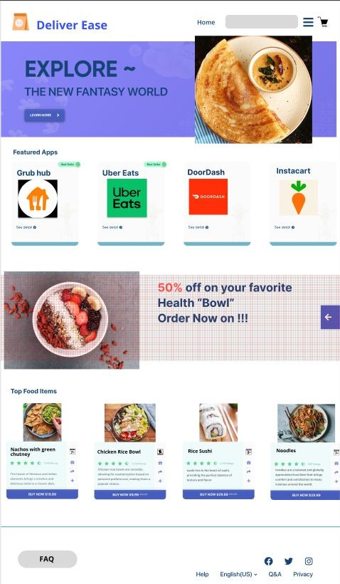


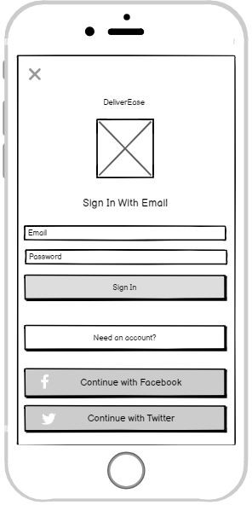
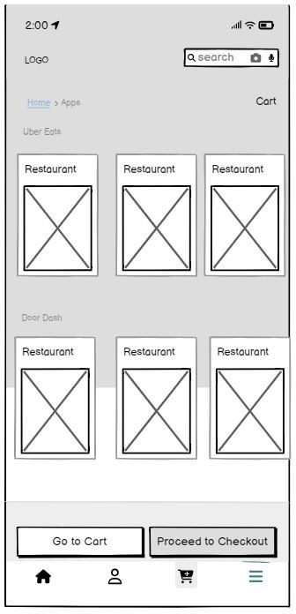
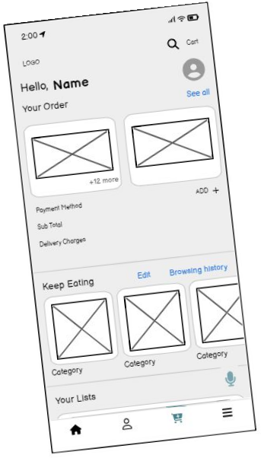
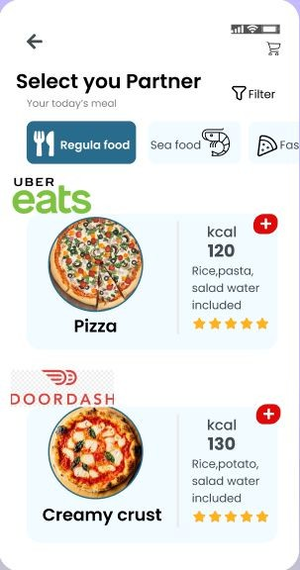
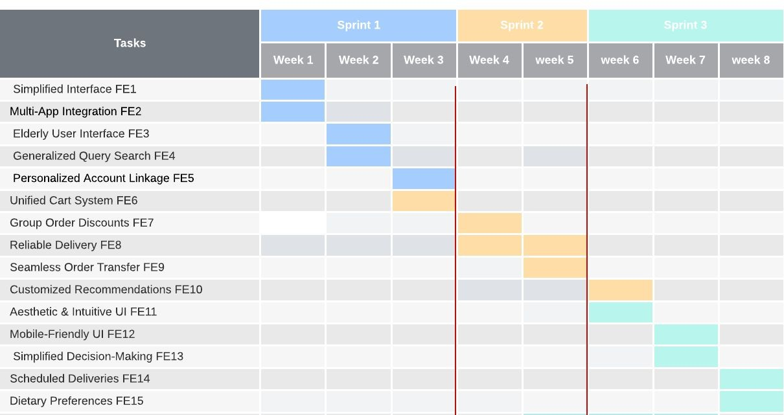

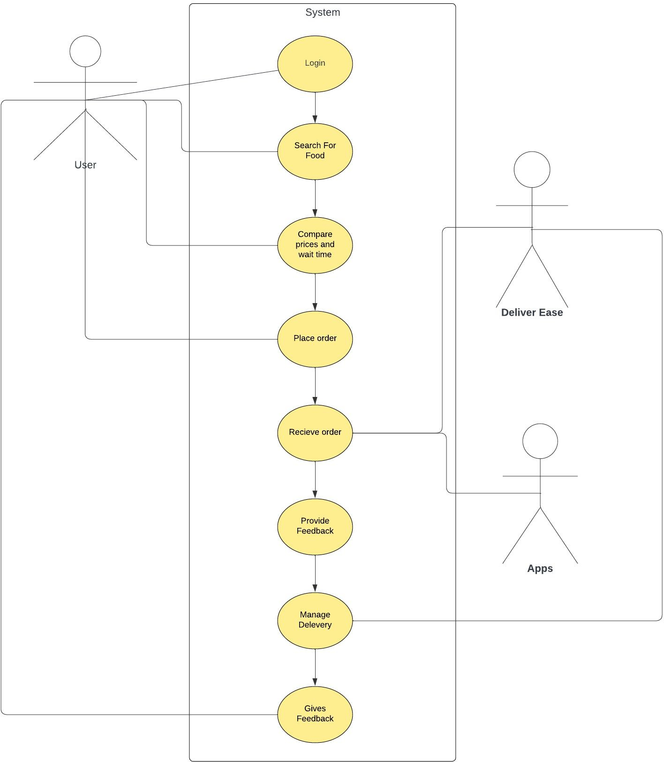
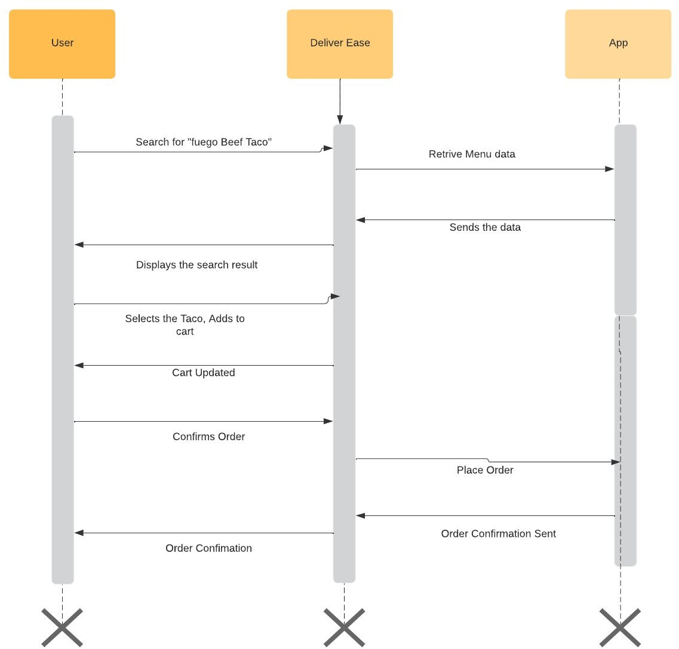
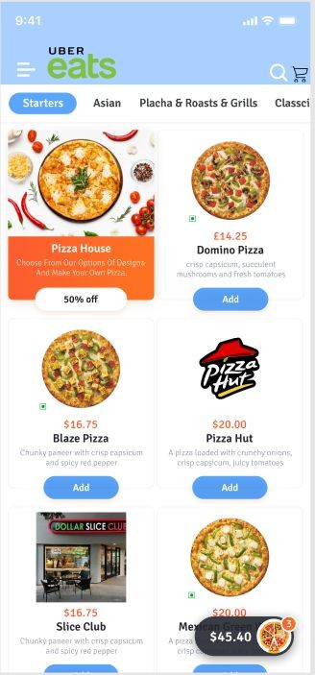
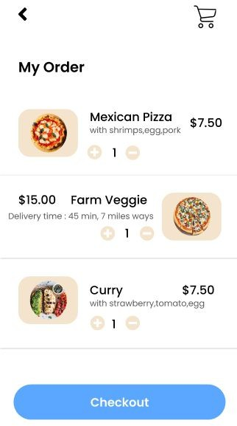
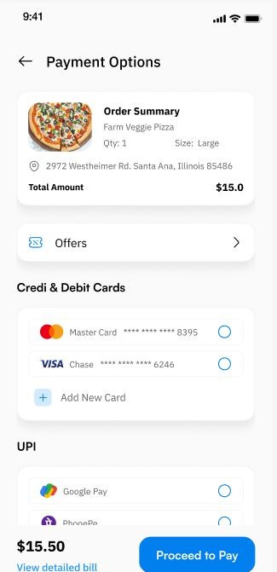
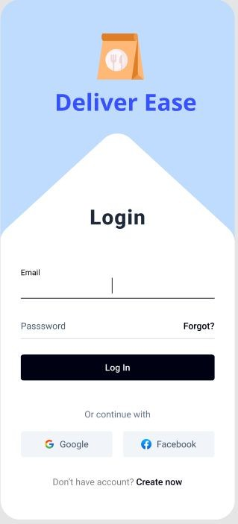


Workflow
Product name Vision & Goal
Epic
Product Success Matrix
User Personas
Wireframe
Mock up
Product Features
Sprint 1, sprint 2, Sprint 3
Weeks 1-8
Sequence Diagram
Use case
Storyboard

Slide 3
Product Name, Vision or Goal.
Product Name : DeliverEase
Vision or Goal
Our mission at DeliverEase is to completely transform the food delivery industry by developing a user-focused, all-inclusive platform that redefines efficiency, affordability, and convenience. Our objective is to tackle the common problems faced by food delivery aficionados across the globe, namely exorbitant prices, extended waiting periods, and the tiresome process of juggling several delivery applications.
Our main objective is to position DeliverEase as the standard solution, providing users looking for the best meal delivery options with a smooth and hassle-free experience. Our goal is to become the preferred platform that helps users enjoy their favourite meals more intelligently while also streamlining the ordering process.

Slide 4
Detailed Vision Elements
Streamlined User Experience: The user interface should be simple and understandable, it should simplify the complexity of comparing prices, wait time, and deals across different delivery services. Our app aims to remove the frustration of switching the multiple apps for offers and price comparison. So, a good user experience will be the grand vision.
Empowering Users with the information: As our app focus on multiple platforms, it is important to provide accurate data to make informed choices. We aim to present transparent data and detailed insights about available options, making sure user is finding what they get.
Optimization of time and cost: our goal is to save users time and cost (if possible). This can be done through seamless interactions with leading food delivery app. We tend to optimize the food ordering process, get user to access the most cost effective and time- efficient delivery options.
Continuous innovation and improvements: The platform will continue to improve and do well. We tend to get out hands involved in the cutting-edge technologies. Such as fuzzy logic algorithms to monitor the tracks of the users. This will ensure that deliver ease will always me up to date and relevant.
Commitment to user satisfaction and trust: User satisfaction plays a major role in setting up standards for the app, we aim to consistently deliver a reliable, secure, and transparent service. We will give the most importance for the user feedback. And make improvements over it.
Impactful industry Transformation: We aim to broder food delivery app, include a lot more app options to choose from. We will set new standards. Our platform will be a menu for change. More apps will be included in future. More partnership will be added. Which will make deliver ease more available and reliable for the users.

Slide 5
Product Success Matrix
Customer Satisfaction
Metric: Ratings left by users in surveys, app stores, and direct feedback channels.
Goal: Keep up a minimum of a 4-star rating in app. Stores and receive positive feedback from 80% of users when conducting surveys.
Generating Revenue
Metric: The total amount of money made from data sales, ad-free versions, and app subscriptions.
Goal: Within the first two years, generate a minimum of $500,000 in revenue annually.
Performance and Functionality
Metric: Performance indicators for apps, like crash rates, error rates, and response times. Goals: Reduce user-reported errors to less than 5%, keep app crashes to less than 1% of sessions, and keep app response times under 3 seconds.
Connectivity with Apps for Food Delivery
Metric: Accomplishment of both primary and secondary food delivery apps' integration.
Goal: Within predetermined timeframes for every version update, establish seamless integration with partnered apps

Slide 6
Big Picture
DeliverEase provides a user-friendly interface which allows users to select the restaurant or menu item of their choice. The application eventually presents an inventory of connected delivery services, along with the costs, delivery durations, and accessible discounts for the chosen item. Customers are able to view the comparison list, pick the exact food item they want, and add products to a cart.
When finished, the cart sends the order to the phone app of the selected delivery service for completion. DeliverEase keeps order details for convenience but does not store financial information.

Slide 7
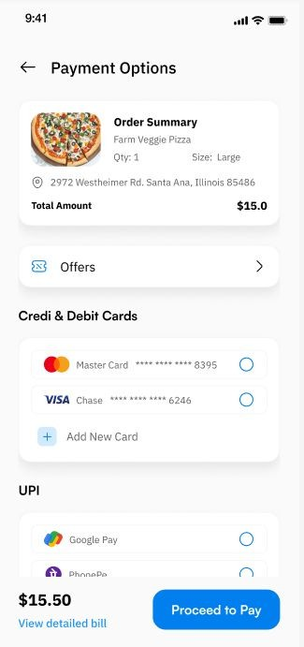
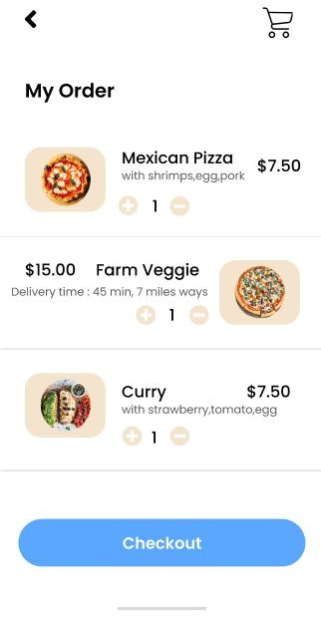

Storyboard
Step 5&6 : Review the cart and proceed for payment.
Step 2 : Home page opens, search or select service.
Step 4: Select the restaurant.
Step 1: User will Login
Step 3: Find your search result, choose your food Partner.

Slide 8



Target Audience
Students
Working Professionals
Old and Retired

Slide 9
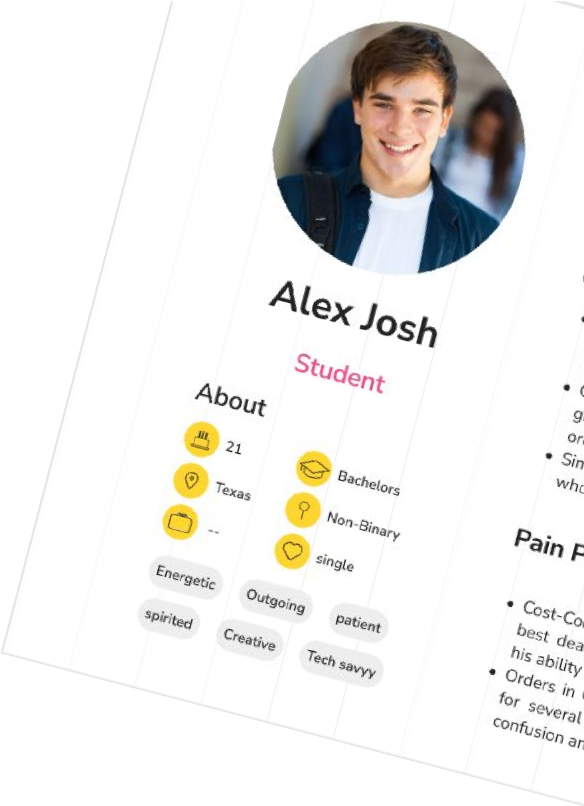
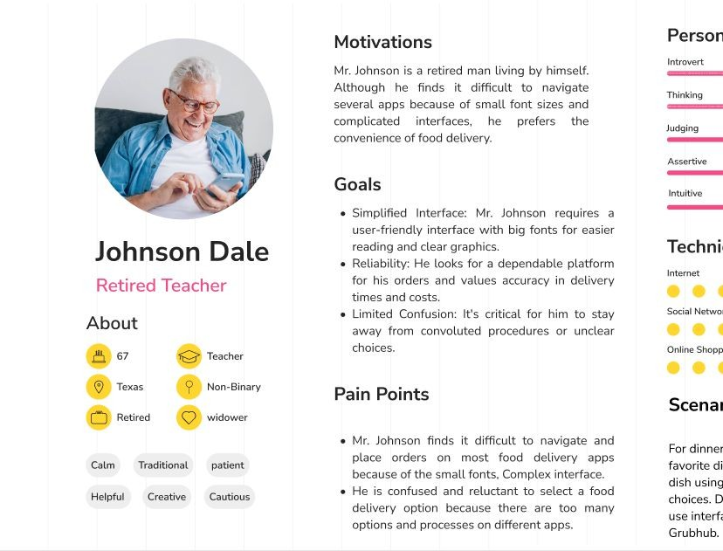


User Persona

Slide 10
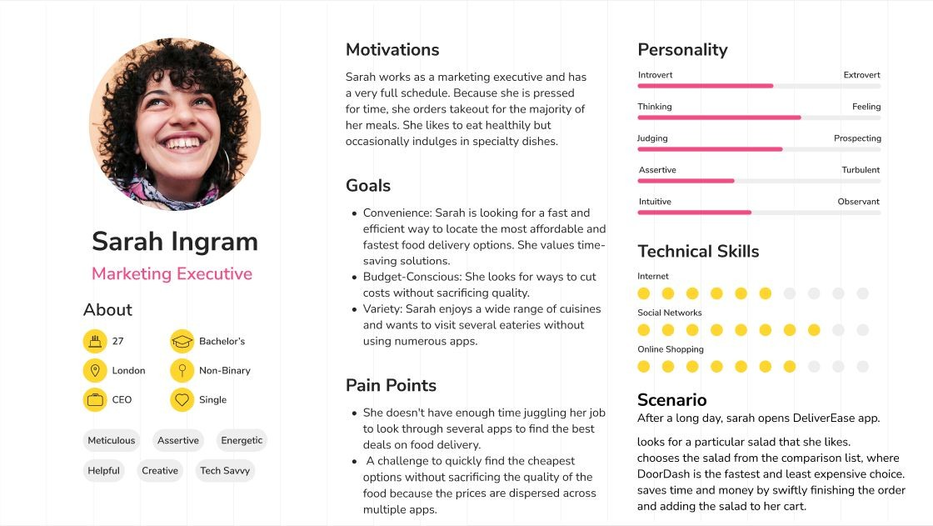
Texas

Slide 11





Motivations
Mr. Johnson is a retired man tîving by himsetf. Aîthough rte flnds it difflcuît to navigate severaL apps because of smaI1 font sizes and œmpficated interfaœs, he prefere the œiwenîenœ of food deÏivery.
Personality
Goals
Simplified Interface: f4r. Johnson requires a
Obamnt
Johnson Dale
Retired Tescher
About
user-friendly Interface with big fonts for easfer reading and clear graphics
Technical Skills
Reliabifi He looks for a dependable ptadorrn for hls orders and values accuracy in delivery times and cot
Limited Confusion- It's critical for him to stay away from convoluted procedures or undear choices.
Pain Points
Scenario
Ratîrad
widowar
Mr. Johnson finds it difficu\I to navigate and place orders on most food delivery apps because of the small fonts. Complex interface.
He is confused and rekictant to select a food
delivery option because there are too many options and processes on different apps.
For dinner. I Ir. Johnson would like to order his favorite dish from a nearby restaurant books for the dish using DeliverEase and evaluates delivery choices. Discovers that Grubhub has the easiest-to use interface. places the order uslng Dell 'erEase to Grubhutx

Slide 12
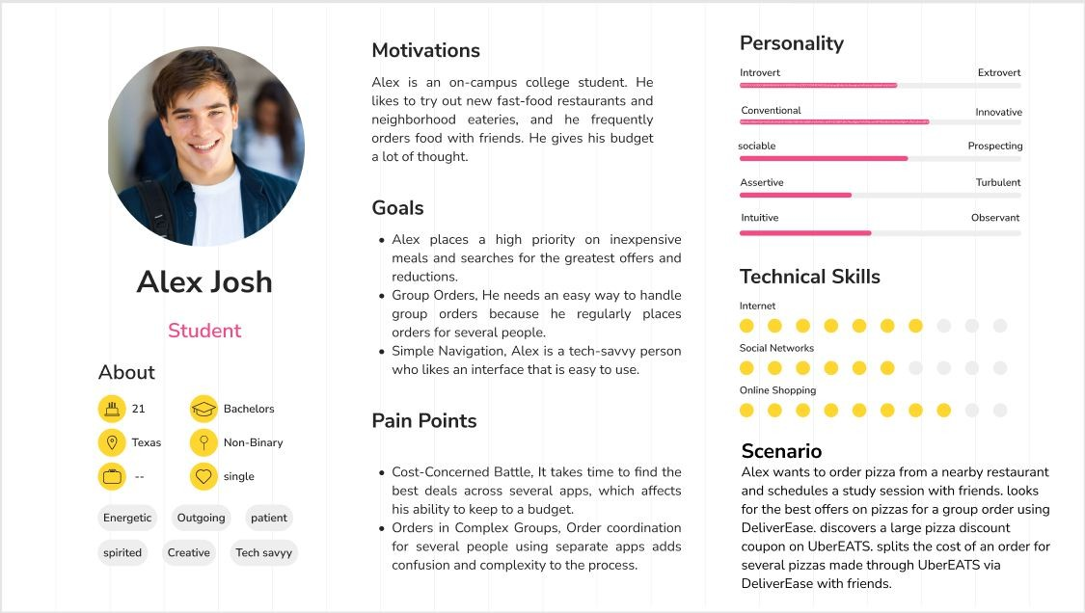

Slide 13
EPIC : To Improve User Experience and Integration
Improves DeliverEase by simplifying app navigation, integrating popular delivery services, and providing tailored experiences for simple meal ordering and comparison while putting the needs of the user first.
Feature1: Unified Search and Comparison, The search button will be much more enhanced which will compare the food restaurants based on prices and show the user results.
Feature 2: Multi-Platform Integration, Seamless interaction with multiple food delivery app
Feature 3: User Account Linkage and Personalization, The user accounts which are made on different delivery app can be linked on the DeliverEase app
Feature 4: Enhanced Cart and Group Order Functionality, The cart can be use for group orders and it also shows offers
Feature 5: Accessibility and User-Friendly Interface, The user interface will have clear visuals, graphics. It will be compatible both on IOS and android.
Feature 6: Scheduled Orders, You can schedule orders if you are getting late or you tend to forget to order on time. This will be useful during sales.
Feature 7: Dietary Preferences and Allergies, In this feature people with dietary preferences and allergies can specify them in a section and later use it as filters to select their food.

Slide 14
Sprint 1
ID
User Story
Acceptance Criteria
priority
Estimation (story point)
FE1
As i am busy (sarah), I want a simplified interface for quick food delivery comparisons.
Information on the screen should display important information such as prices, delivery schedules, and available discounts, is important interface design.
High
8
It should be easy for users to navigate the app; it should only take two taps to view delivery options that are comparable for a given restaurant or food item.
FE2
I (Alex, a college student) want multi-app integration so that I can compare costs and deals on different platforms.
Accurate menu items, prices, and delivery times for a searched query should be displayed via integration with Grubhub, DoorDash, and UberEATS.
High
13
Real-time updates on any discounts or coupons that are available for the chosen items from each app should be provided by the system.
FE3
As an elderly person I want a more straightforward interface with larger fonts and clear images for improved readability
Larger fonts on the interface will ensure clear readability even for users who have vision problems or have trouble reading small text.
Medium
5
For easier navigation, visual components like buttons, icons, and menu items should be clear and easy to identify.
FE4
As a user, I want the search feature to accept the generalised queries
It should be easy for users to conduct searches and receive thorough results even in the case of misspellings or incomplete entries.
Medium
5
FE5
As a user, I want a personalized account linkage as a user so that I can take advantage of loyalty benefits and preferred pricing.
A strong authentication system should be used by users to safely connect their accounts from various delivery apps within DeliverEase.
High
8
User-specific discounts, preferred pricing, and loyalty rewards connected to their individual linked accounts should be retrieved and displayed by the app.

Slide 15
Sprint 2
ID | User Story | Acceptance Criteria | Priority | Estimation (story point)
FE6 | As Sarah, i want to add | Features in the cart that let users add and control items | High | 13
 | products from different | from various platforms.
 | restaurants and apps to
 | a single cart system. | A summary of the chosen items, including their prices,
 |  | quantities, and delivery information, should be shown in
 |  | the cart interface.
FE7 | As Alex, i want to find | The system should to recognize and highlight any | High | 10
 | the greatest group order | discounts or offers that are particularly relevant to group
 | discounts and offers. | orders.
FE8 | As Mr. Johnson, I want | The delivery times that are shown ought to be precise and | Medium | 8
 | reliable delivery times | in line with the data from the corresponding delivery apps.
 | and prices to minimize
 | confusion.
FE9 | As a user, I want my | With just one click, users should to be able to move their | Medium | 10
 | completed orders to | completed cart items to the appropriate delivery apps.
 | transfer seamlessly to
 | the delivery apps of my | DeliverEase should confirm to users that their order has
 | choice. | been transferred successfully.
F10 | As a user, I would like | In order to recommend related or complimentary | Medium | 8
 | customized | products, the recommendation system ought to examine
 | recommendations | users' previous orders and preferences.
 | based on previous
 | purchases.

Slide 16
Sprint 3
ID | User Story | Acceptance Criteria | priority | Estimatio n (story point)
F11 | As Sarah, I want an interface that is both aesthetically pleasing and intuitive. | The input from user testing sessions or surveys should serve as the foundation for the user interface improvements. Simple navigation should make it easy for users to access essential features without getting lost. | High | 8
F12 | As Alex, I want an intuitive user interface that is mobile-friendly. | In order to provide the best possible viewing experience across a range of mobile devices, the interface should be responsive to changes in screen size. The interface should maintain consistency across iOS and Android platforms. | High | 8
F13 | As Mr. Johnson, I desire simple procedures and unambiguous graphics to facilitate decision-making. | To avoid overwhelming the user, complex options or features should be simplified or visually divided. I want data visualization and export capabilities as a user so I can examine usage trends. | Medium | 5
F14 | As a user, would like to be able to schedule food deliveries in advance, In order to plan meals and have them delivered at a specific date and time. | Permit users to plan their orders according to their preferences for future dates and times. Send users notifications or reminders to confirm their orders prior to the scheduled delivery time. | Medium | 8
F15 | As a user, I want to be able to set my allergies and dietary preferences, so that the food options that are displayed meet with my dietary requirements. | Provide a space where users can indicate their dietary restrictions (vegan, vegetarian, gluten-free) and allergies (dairy, nuts, etc.). To aid in decision-making, filter and present food options according to the user's specified dietary requirements. | High | 10

Slide 17
Product Features

Slide 18
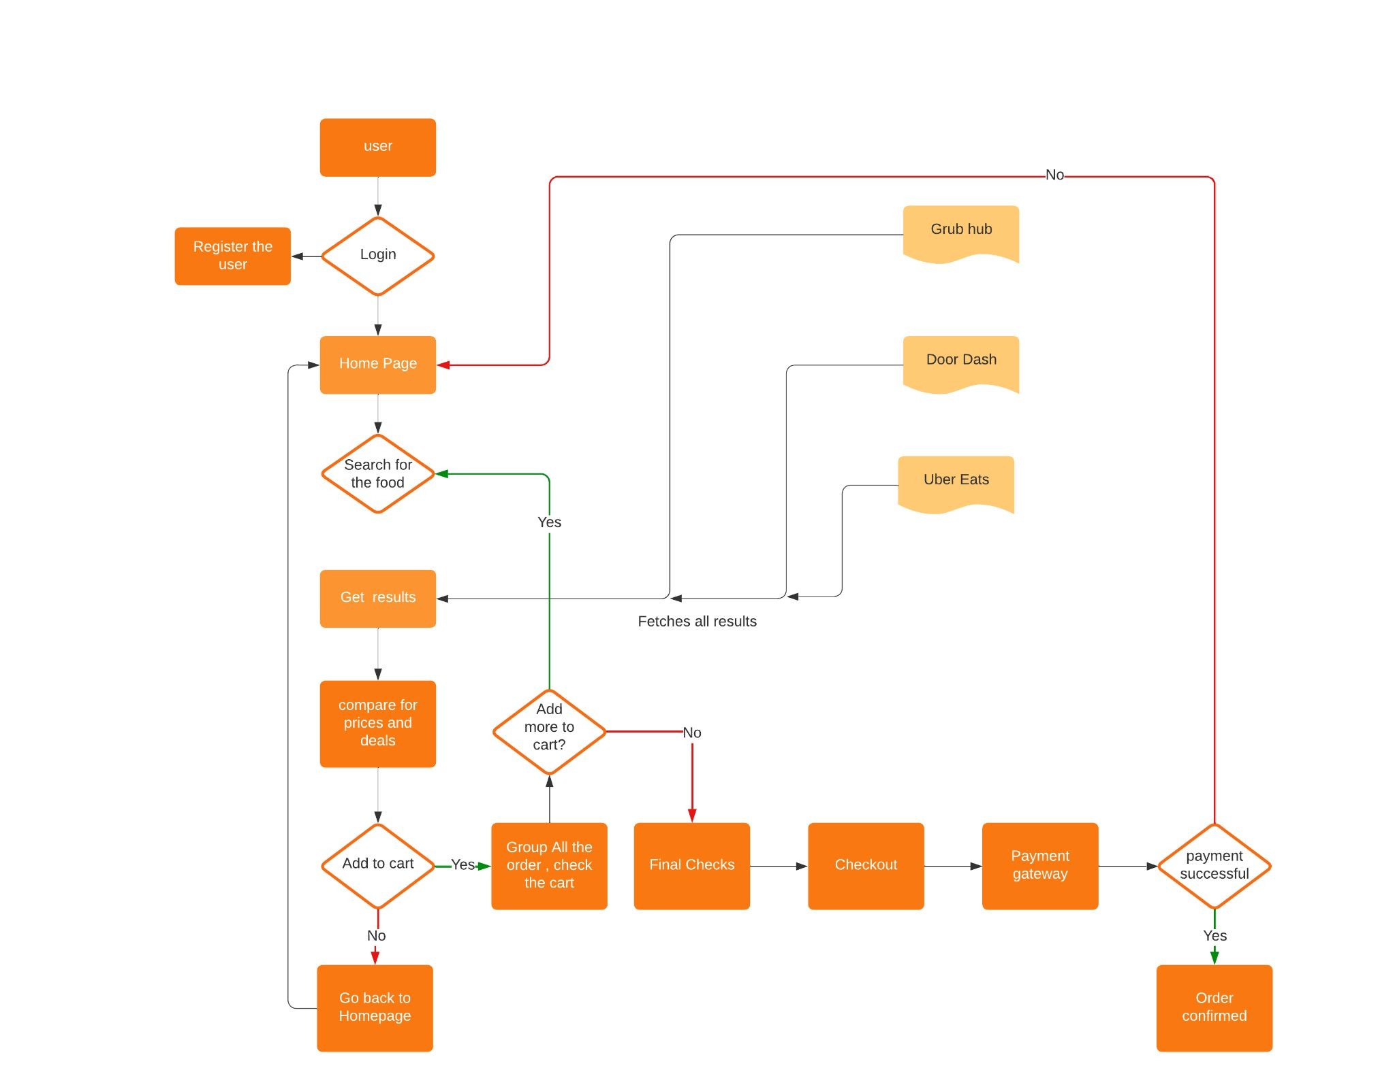
Workflow Diagram (User)

Slide 19
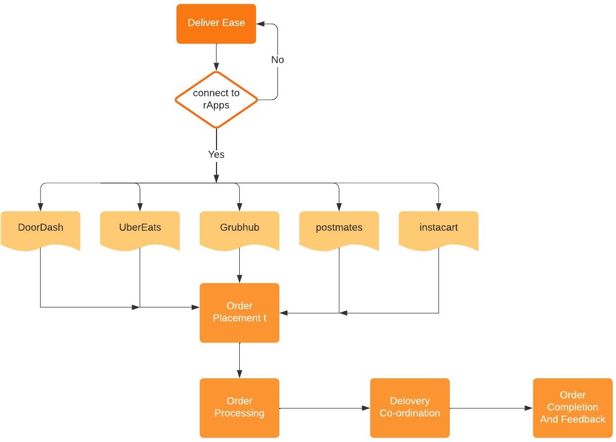
Workflow Diagram ( Restaurant)

Slide 20
Use Case

Slide 21
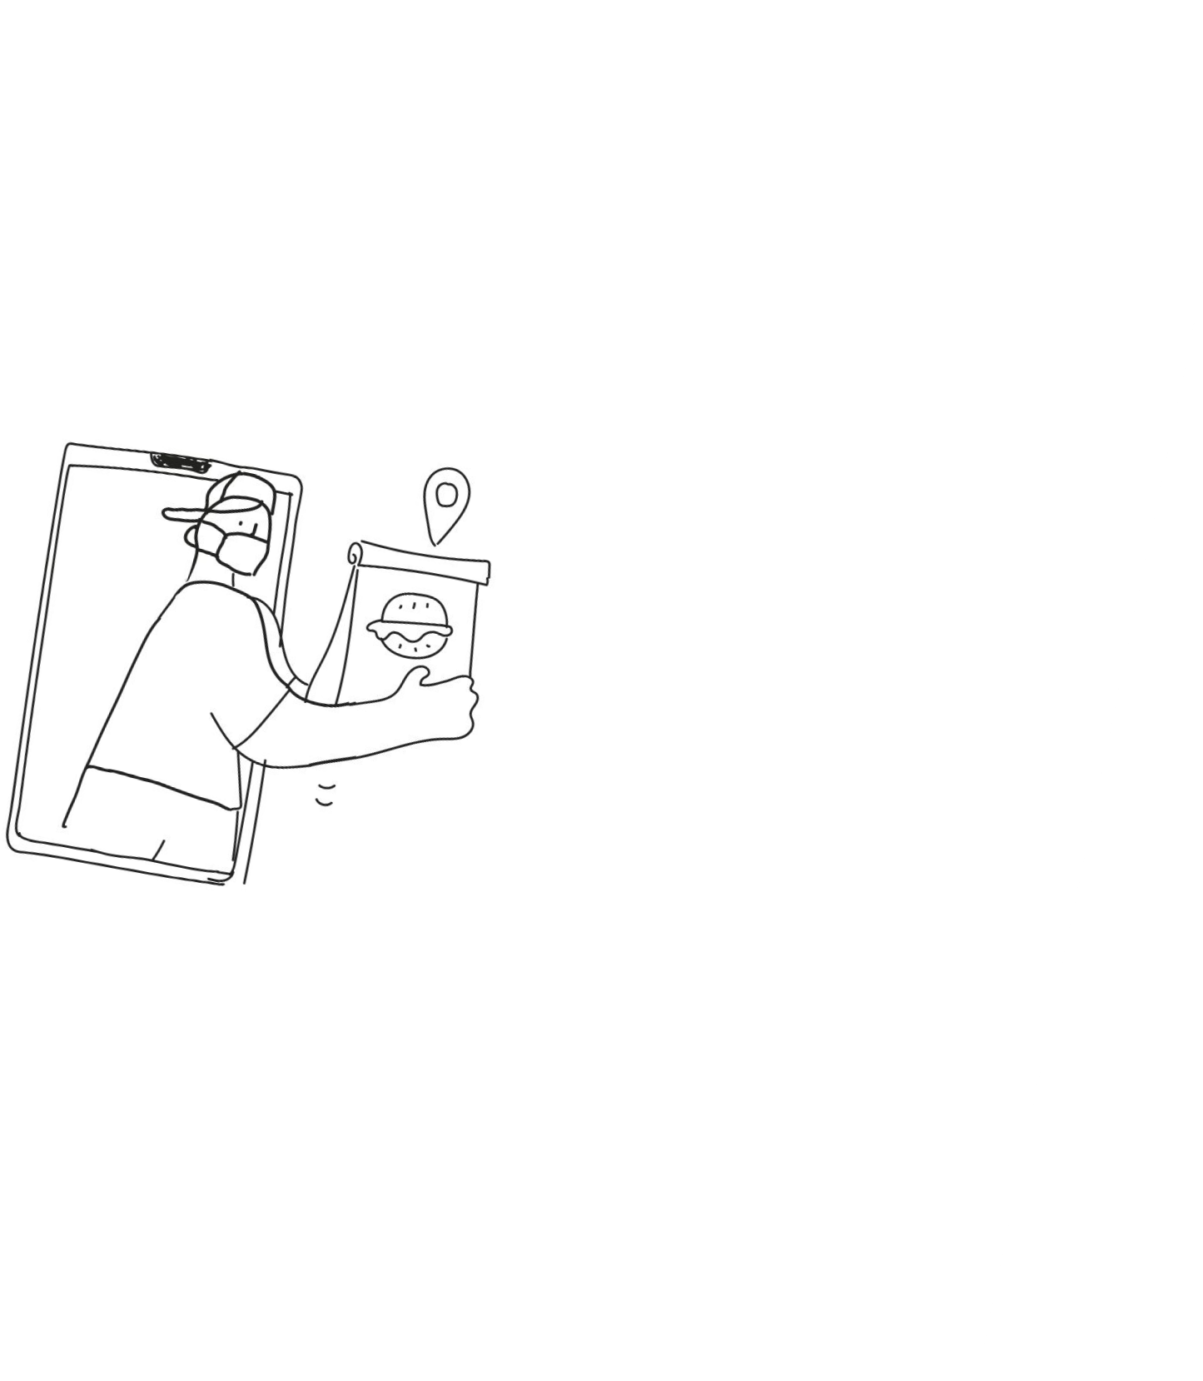
Sequence Diagram

Slide 22

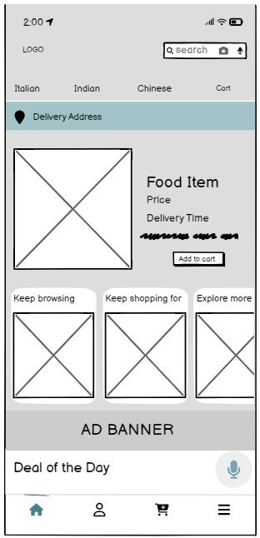
Wire Frame
Login Page, User can login with their email or even create an account.
List of Apps like Uber Eats, Doordash etc, are displayed after a user searches for a food item. User can choose after comparing the apps.
The Food review page, The delivery time, price and description is mentioned.

Slide 23
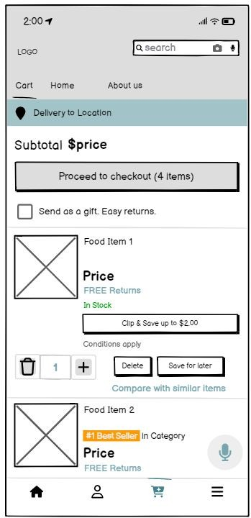
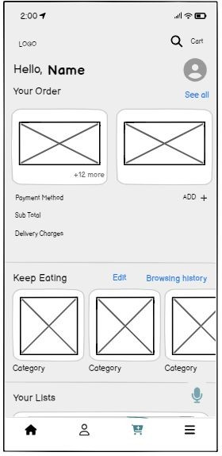
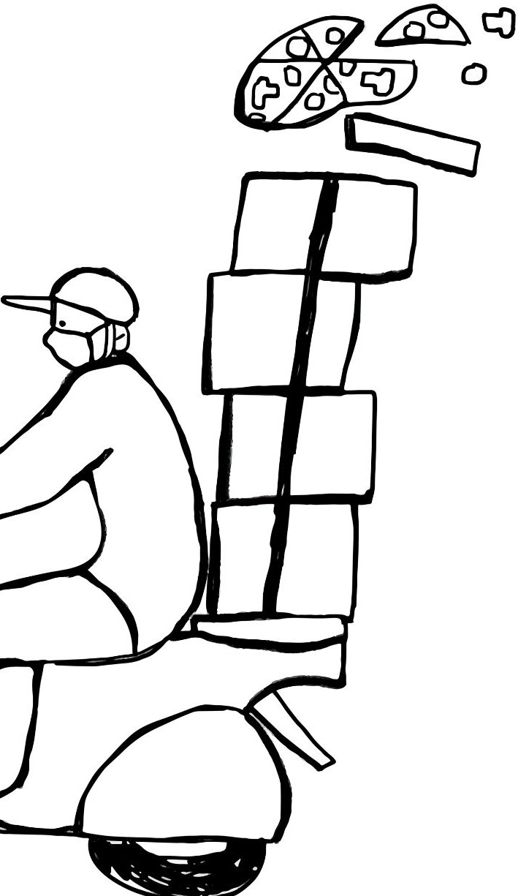
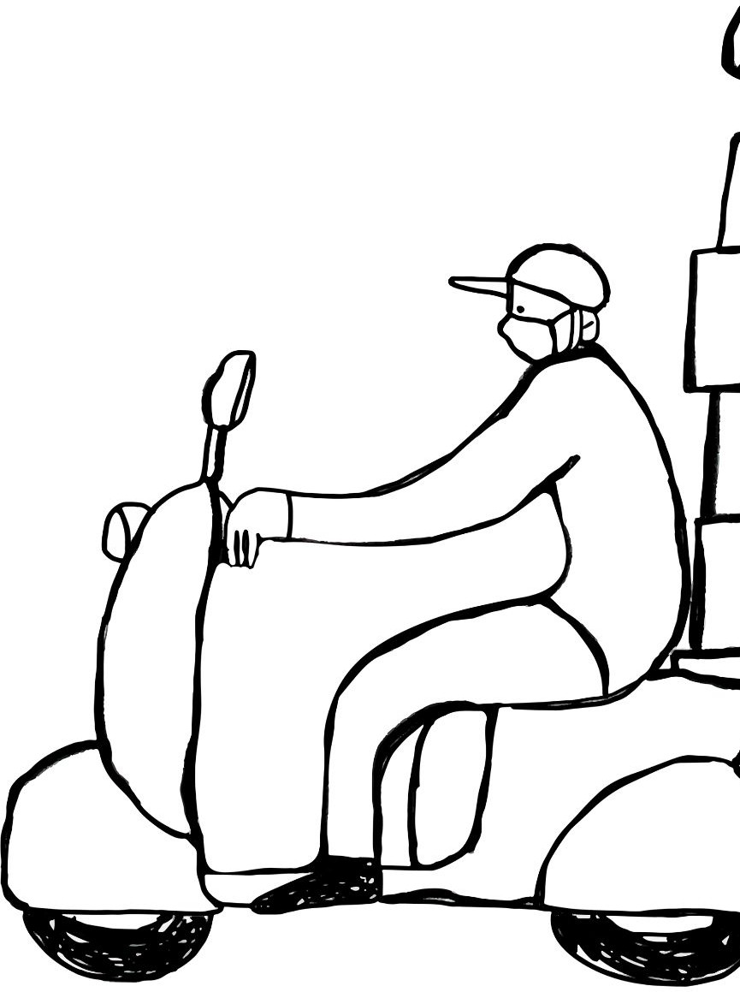
Cart page, The items that are added in the cart can be seen here, we can proceed to payment if everything is looking fine.
This is the payment page, the total bill will be displayed and additional explore option is also displayed

Slide 24
Mock Up
Login page
Home Page
Select best option
Login with email and password, or create an account.
Select or Search for the food items, find the top food times section for more fun.
Select the best deals offered by the partners to get discount on food.

Slide 25
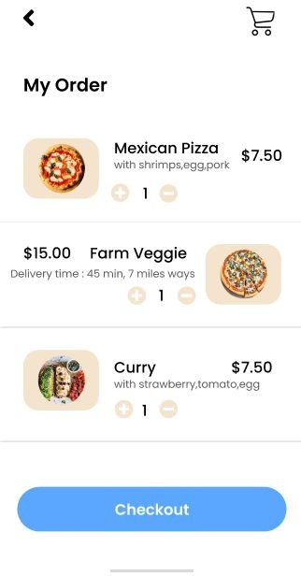
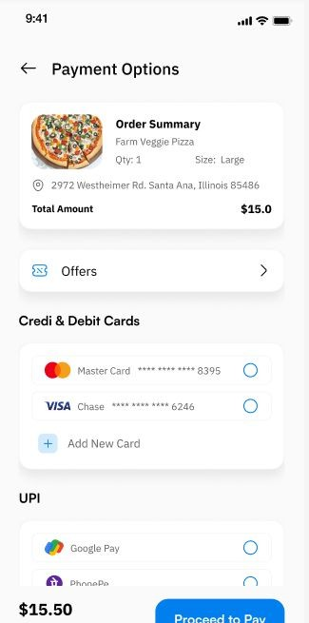
Cart Page
Menu Page
Check out Page
User Chooses the restaurant they want to order from in Uber eats.
The user Reviews the cart, checks for the prices and offers. And then proceeds to checkout.
The cards will be displayed, the order summary is also displayed. Ussr can proceed to pay

Slide 26
THANK YOU

